Slide 1
World Book Day Quiz
2018

Slide 2
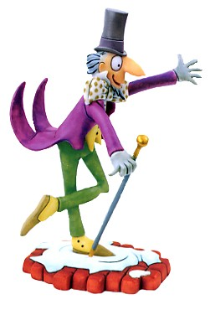
1. Who is this famous book character?

Slide 3
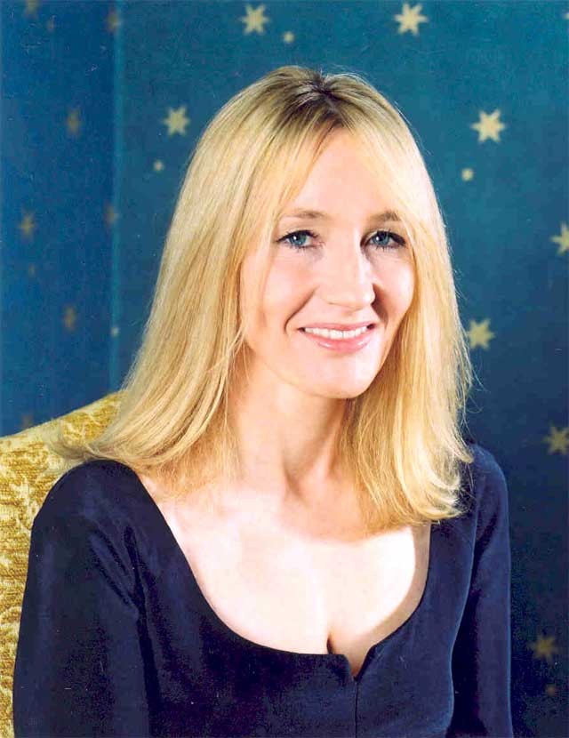
2. Who is this famous author?

Slide 4
3. The author Michael Morpurgo writes books mainly about what?
A. Witches & Wizards
B. Science Fiction
C. Adventures set in real places
D. Comedy

Slide 5
4. Which one of Roald Dahl’s characters is being described here?
“She was above all a most formidable female. She had once been a famous athlete and even now the muscles were still clearly in evidence. You could see them in her bull neck, big shoulders, the thick arms, the sinewy wrists and in the powerful legs. Looking at her you got the feeling this was someone who could bend iron bars and tear telephone directories in half.”

Slide 6
5. What is the name of Mr Filch’s cat in Harry Potter?
A. Mrs Lorris
B. Mrs Morris
C. Mrs Doris
D. Mrs Norris

Slide 7
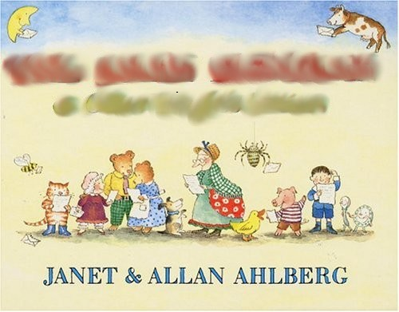
6. This is the front cover of which children’s book?

Slide 8
7. Who wrote a collection of books called ‘A Series of Unfortunate Events.’

Slide 9
8. Who wrote the following list of books?
‘The Island of Adventure.’
‘First Term at Malory Towers.’
‘Five Go Adventuring again.’
‘The Enchanted Wood.’

Slide 10
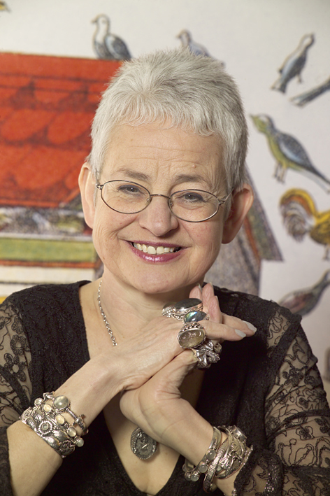
9. Who is this famous children’s author?

Slide 11
10. Which author wrote the following books?
Demon Dentist
Ratburger
Billionaire Boy

Slide 12
11. The book ‘The Sheep Pig’ by Dick King Smith was turned into which blockbuster film?

Slide 13
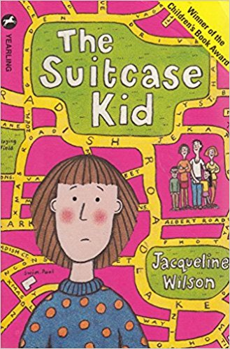
12. This is the front cover of which Jacqueline Wilson book?

Slide 14
13. Anthony Horrorwitz wrote the following of books all about which character?
StormBreaker
‘Point Blanc’
‘Skeleton Key’
‘Scorpia’

Slide 15
14. What did Jack NOT steal from the giant in ‘Jack and the Beanstalk’?
A. A bag of gold.
B. A golden fleece
C. A golden harp.
D. A goose that laid golden eggs.

Slide 16
15. Which word has been blanked out from the front of this book?

Slide 17

16. Which children’s book character is this?

Slide 18
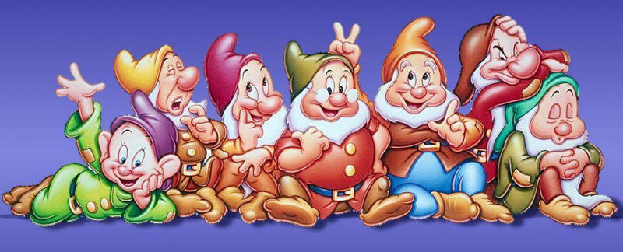
17. Name all of Snow White’s Seven Dwarfs. (One point for each!)

Slide 19
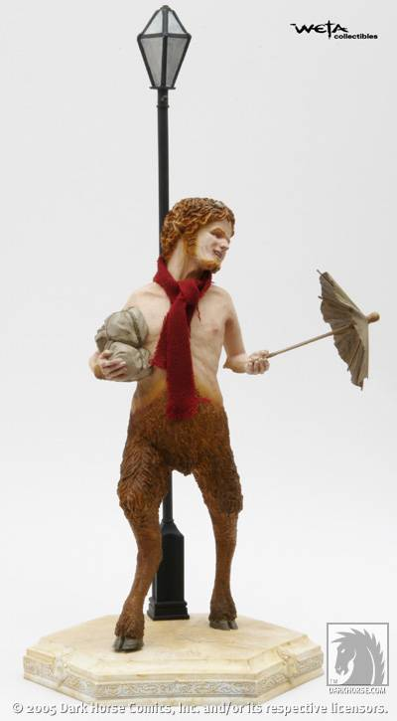
18. What was the name of this character in ‘The Lion, The Witch and The Wardrobe’?

Slide 20
19. Which of the following books has NOT been turned into a film yet?
‘The Twits’
‘The Lion the Witch and the Wardrobe’
‘Awful Auntie.’

Slide 21
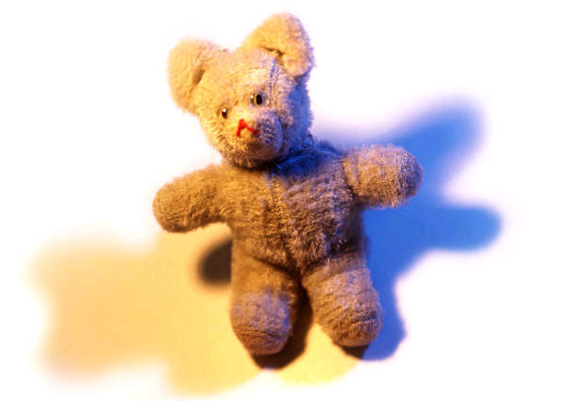
20. Which famous bear lived in Hundred Acre Wood?
A. Winnie-the-Pooh
B. Rupert
C. Paddington
D. Yogi

Slide 22
21. Which magical character is this describing?
His eyes were black like Hagrid’s but had none of Hagrid’s warmth. They were cold and empty and made you think of dark tunnels. He spoke in barely more than a whisper but you caught every word. He swept around in his long, black cloak criticising everyone.

Slide 23
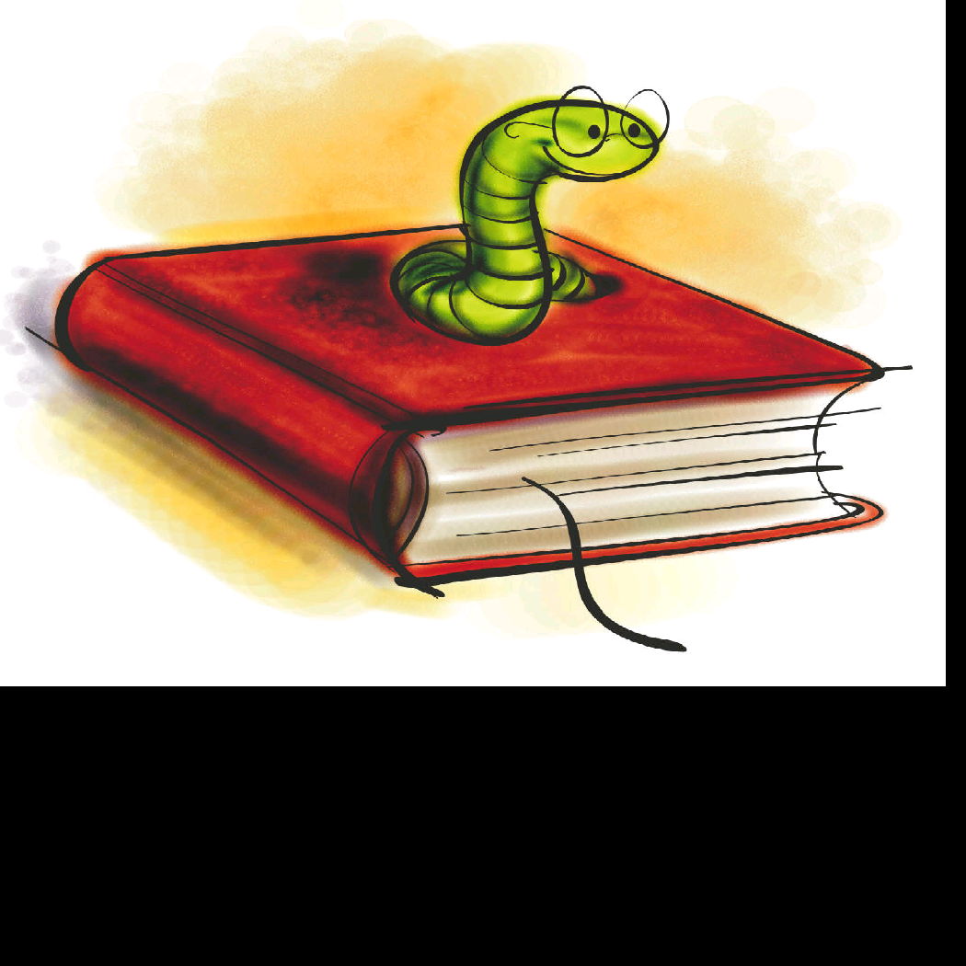
22. How many children’s books, including picture books, has David Walliams written?
A. 12
B. 17
C. 15
D. 29

Slide 24
23. Fill in the blanks and look at the pictures to find the title of this famous Dr. Seus book.
_ _ _ _ _ _ _ _

Slide 25

24. Which brothers were famous for writing fairy tales?

Slide 26
25. What was the first children’s book Roald Dahl ever wrote?

Slide 27
Tie-Breaker!
In which year was The Lion, The Witch and The Wardrobe first published?
(The team closest to the correct year goes through to the final!)

